Slide 1
LECTURE 1

Slide 2

Motion
Motion and Rest
Motion is relative

Slide 3
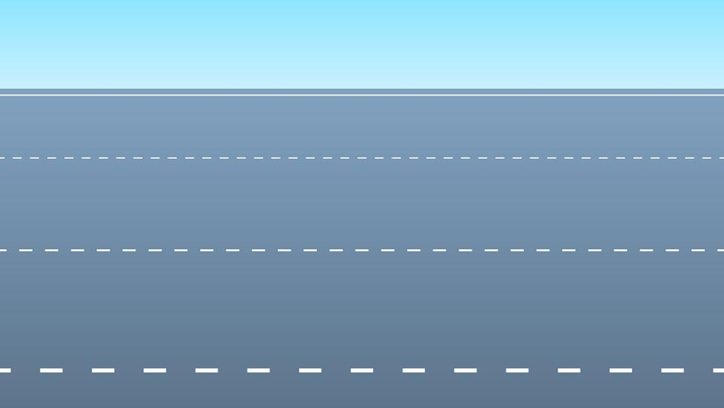







What do we observe ?
Let’s learn in this chapter
MOTION
We observe that the objects are in MOTION
Why do we say these objects are in motion

Slide 4






What is meant by MOTION?
Let us consider an example of an observer observing the car
So, the car is
in MOTION
A BODY IS SAID TO BE IN MOTION WHEN IT CHANGES ITS POSITION WITH RESPECT TO ITS SURROUNDINGS.
The position of the car is changing with respect to its surroundings

Slide 5


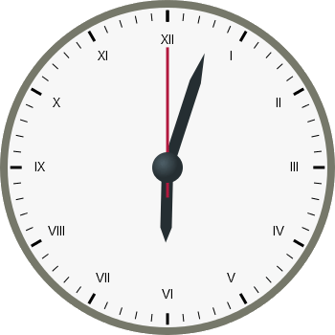
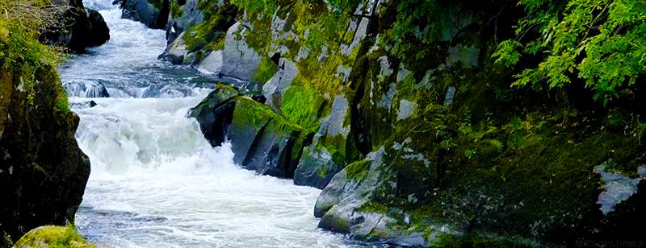


The position of the hands of the clock CHANGES continuously
In a river, the position of water CHANGES continuously
Due to revolution, the position of the earth with respect to the sun CHANGES continuously
So, the hands of the clock are in MOTION.
So, water is in MOTION
So, the earth is in MOTION.

Slide 6


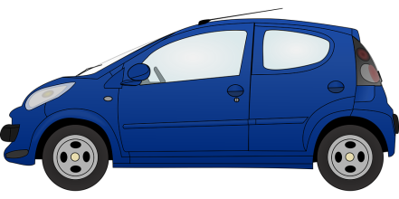
A BODY IS SAID TO BE AT REST WHEN IT DOES NOT CHANGE ITS POSITION WITH RESPECT TO ITS SURROUNDINGS.
Let us consider an example of an observer observing the car stopping at a signal
Then, what is meant by REST..?
The position of the car is NOT changing with respect to its surroundings
So, the car is at REST

Slide 7
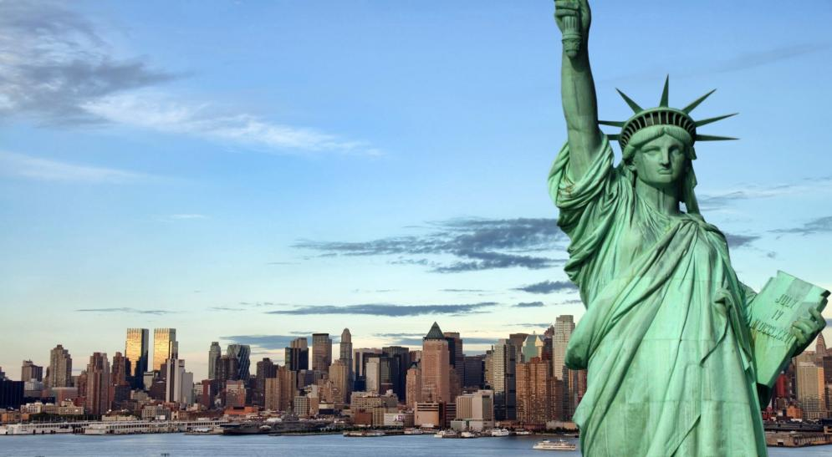

MOTION IS RELATIVE

Slide 8
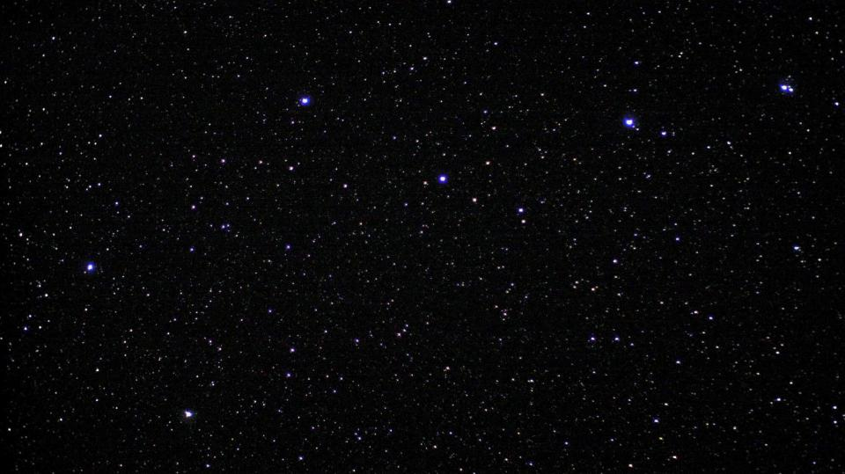

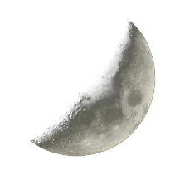


MOTION IS RELATIVE
Depends on the observer
A body can be moving for one observer, and at the same time at rest for another observer.
MOTION IS RELATIVE

Slide 9
MCQ’s
1. Motion is said to be
a) Relation
b) Relative
c) Changing
d) None
2. When in motion the body changes its _______ with respect to its surroundings.
a) Size
b) Shape
c) Position
d) No change
3. An object may appear to be moving for one person and ____________ for another person.
a) stationary
b) motion
c) changing
d) relation

Slide 10
1. Define Motion
Ans. A body is said to be motion if it changes its position with respective to its surroundings.
2. Define Rest
Ans. A body is said to be at rest if it does not change its position with respective to its surroundings.
3. Motion is relative
Ans. A body can be moving for one observer, and at the same time at rest for another observer.

Slide 11
Motion
Uniform and Non-uniform motion
Activity on motion

Slide 12


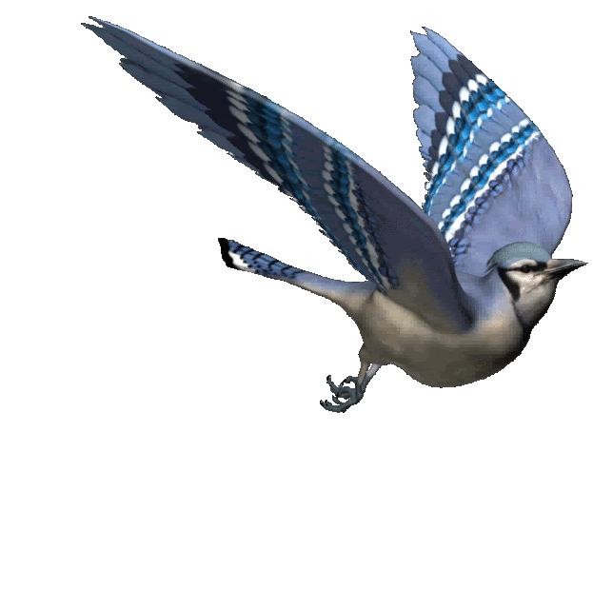
Uniform Motion
Non-Uniform Motion
1. The motion in which the object covers equal distances in equal intervals of time is called uniform motion.
1. The motion in which the object covers unequal distances in equal intervals of time is called Non-uniform motion.
2. In uniform motion acceleration is zero
The hands of the clock cover equal distances in equal intervals of time
2. In non-uniform motion acceleration is not constant
A flying bird covers unequal distances in equal intervals of time

Slide 13
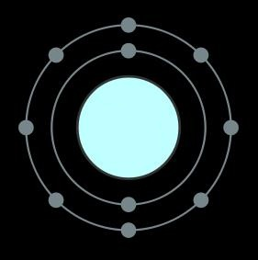
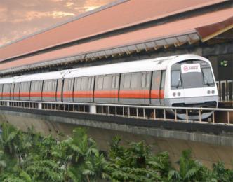
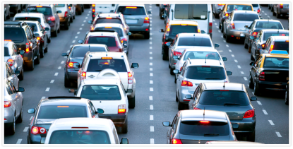
IDENTIFY THE TYPE OF MOTION
Uniform Motion
Non-Uniform Motion
e⁻
Unequal distances in equal intervals of time
Unequal distances in equal intervals of time
Equal distances in equal intervals of time.
Equal distances in equal intervals of time.
Unequal distances in equal intervals of time
n
p⁺
Motion of the bird
Motion of vehicles on an extremely busy road
Motion of electrons round the nucleus
Train arriving / Leaving the station
Motion of the hands of the clock

Slide 14




Activity
Amar , Akbar and Anthony are travelling by their own cars.
Lets us understand whose car is moving with uniform motion.
Amar
Akbar
Anthony
Clock Time
Distance covered by
Amar in kilometer
Distance covered by Akbar in kilometer
Distance covered by Anthony in kilometer
5.00
0
0
0
30
20
18
14
5.30
20
18
14
30
20
18
14
6.00
40
36
28
30
20
6
14
6.30
60
42
42
30
20
28
14
7.00
80
70
56
30
20
25
14
7.30
100
95
70
30
20
25
14
8.00
120
120
84

Slide 15
LECTURE 2

Slide 16
Motion
Physical quantities
System of Units

Slide 17
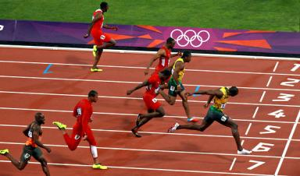
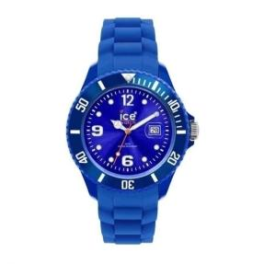

Physical Quantities
Can DISTANCE be measured?
YES
Can TIME be measured?
DISTANCE is a physical quantity
YES
TIME is a physical quantity
Anything that can be measured is a PHYSICAL QUANTITY.
Can LOVE be measured?
NO
LOVE is not a physical quantity

Slide 18
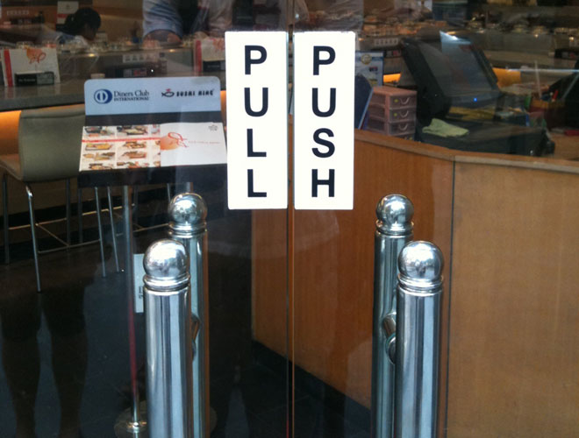

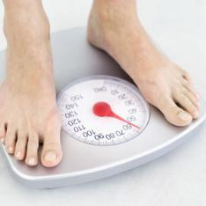

Physical Quantities
Physical quantities are of two types
Scalars
Vectors
To measure force, both magnitude and direction are required. So it is a vector quantity
Physical quantities which can be completely described by their magnitude alone are called ‘Scalar Quantities’.
To measure mass, direction is not required. So it is a scalar quantity
Physical quantities which possess magnitude as well as direction are called ‘Vector Quantities’.
Magnitude means value or a number
To measure time, direction is not required. So it is a scalar quantity
To measure displacement, both magnitude and direction are required. So it is a vector quantity
Examples: Time,
Mass etc
Examples: Force,
Displacement etc

Slide 19
UNITS
Units are a system of measurement.
M.K.S. System
C.G.S. System
Two systems of measurement
meter – kilogram – second
centimeter – gram – second
S.I. System
It is also called as
System International units
OR
Standard International units

Slide 20
Motion
Distance and Displacement

Slide 21
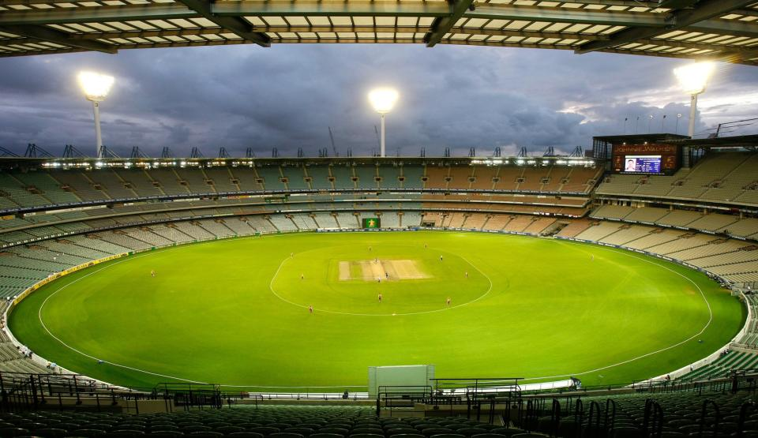


CONCEPT OF DISTANCE & DISPLACEMENT
An athlete is running a race
“A” is the initial point
Let us say, the shortest distance between A (initial) & B (final point) is 160m
START
The actual path run by the athlete is called ‘Distance’
The shortest distance between the initial and final point is ‘Displacement’
“B” is the final point
The athlete is covering a path of 250m between A & B
A
250 m
B

Slide 22
CONCEPT OF DISTANCE & DISPLACEMENT
The shortest distance between A (final point) & A (initial point) is zero
Now the athlete is running from A to A
So the displacement is zero
The path covered by athlete is 500 m
So the distance is 500 m
START
A
500 m

Slide 23
Distance
Displacement
From A to B
250 m
160 m
From A to A
500 m
0 m
START
A
B

Slide 24
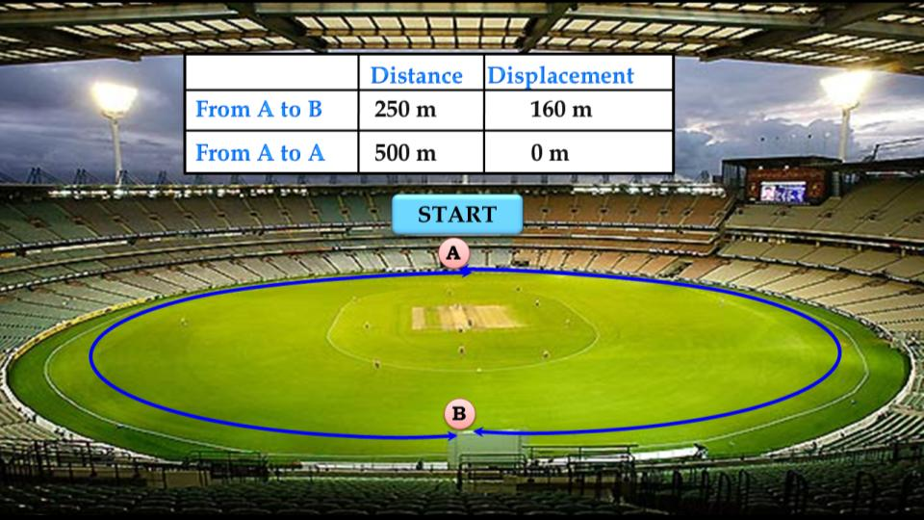
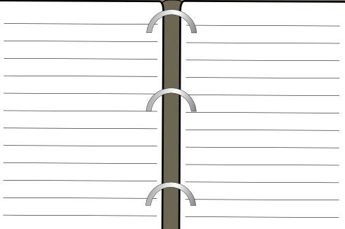
Distinguish between Distance & Displacement
Distance
Displacement
Distance is the total path travelled by an object
The shortest distance measured from the initial to the final position of an object is known as the displacement
Needs only magnitude no direction
Needs both magnitude & direction
It is a scalar quantity
It is a vector quantity
It is either equal to or greater than displacement
It is either equal to or less than distance.
In a straight line motion ,
Distance = Displacement

Slide 25

1 - In the given figure, object starts its motion at point A, goes to B-C-D and again came back to A. Find DISTANCE at point A.
B
5m
C
A
0
B
16
3m
3m
C
can’t say
D
8
A
D
5m
2 - In the given figure, object starts its motion at point A, goes to B-C-D and again came back to A. Find DISPLACEMENT at point A.
B
5m
C
A
0
B
16
3m
3m
A
D
C
can’t say
D
8
5m

Slide 26
3 - Vectors are physical quantities which possess ……………
A
magnitude
B
magnitude & direction
C
direction
D
either magnitude are direction
4 - When a athlete runs on a circular track and reaches the same point ……………
A
Displacement = distance
B
Distance > displacement
C
Displacement > 0
D
Distance < displacement
5 - Displacement is _____________ quality.
A
vector
B
scalar
C
Both of these
D
none of these

Slide 27



An object has moved through a distance. Can it have zero displacement? If yes, support Your answer with an example.
Ans.
Yes, even when an object moves through a distance it can have zero displacement.
A
30 km
B
Total distance travelled
= AB + BA = 30 + 30 = 60 km.
But as the final position coincides with the initial position, the displacement is zero.

Slide 28
Which of the following is true for displacement?
(a) It cannot be zero.
(b) Its magnitude is greater than the distance travelled by the object.
Ans.
Both these statements are not true, because
(a) Its magnitude can be zero.
(b) Its magnitude is either less than or equal to the distance travelled by the object.

Slide 29
Motion
Speed and Velocity
Units and their relation

Slide 30


SPEED
VELOCITY
The displacement of a body in unit time is called velocity Or Speed of an object in a particular direction.
1
The distance travelled by the object in unit time is called speed.
1
2
distance
2
displacement
Speed
=
Velocity
=
time
time
3
It is a scalar quantity
3
It is a vector quantity
Needs only magnitude no direction
Needs both magnitude & direction
4
It is either equal to or greater than velocity.
4
It is either equal to or less than speed.

Slide 31

m
UNIT
distance
cm
speed =
s
s
time
M.K.S
=
m/s
C.G.S
=
cm/s
∴ Units of speed & velocity are the same
- Speed is related to distance.
- Velocity is related to displacement

Slide 32

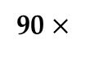
Commercial unit of Speed and Velocity is km/h
Conversion of commercial unit to SI unit
Example
1 km = 1000 m
1 hr = 60 min
5
5
90 km/hr =
90 $×$
1 min = 60 sec
18
1
=
25 m/s
1 hr = 60 × 60 sec
∴1 hr = 3600 sec
1
5
18 km/hr =
18 ×
5
18
1000 m
1
1 km/hr
=
3600 s
=
5 m/s
18
5
1 km/hr
=
m/s
18

Slide 33
Under what condition(s) is the magnitude of average velocity of an object equal to its average speed ?
Ans.
The magnitude of average velocity of an object is equal to its average speed only if the object is moving in a straight line.
A
B

Slide 34
A cheetah is the fastest land animal and can achieve a peak velocity of 100 km/h up to distances less than 500 m. If a cheetah spots its prey at a distance of 100 m, what is the minimum time it will take to get its prey, if the average velocity attained by it is 90 km/h?
90 km
90 × 5 m
Ans.
Average velocity =
90 km/h
=
=
=
25 ms^{–1}
1 h
18 s
Displacement
Also, Average velocity
=
Time taken
Q
Cheetah moves in a straight line displacement is equal to 100 m
100
∴ Time taken
=
=
4 s
25

Slide 35
LECTURE 3

Slide 36
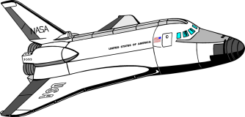
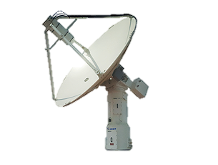
1
During an experiment, a signal from a spaceship reached the ground station in five minutes. What was the distance of the spaceship from the ground station? The signal travels at the speed of light, that is, 3 × 10⁸ m s^{–1}.
Given :
Time (t)
= 5 min
= 5 × 60
= 300 s
v = 3 × 10⁸ ms^{–1}
Speed of the signal
= 3 × 10⁸ m s^{–1}
To find :
Distance
= ?
t = 5 min
Distance travelled
Formula :
Speed =
Time taken
Distance travelled
Solution :
Speed =
Time taken
∴
Distance travelled =
Speed × Time taken
=
3 × 10⁸
× 300
= 3 × 10⁸
Ans :
×
3 × 10²
The distance of the spaceship from the ground station is 9 × 10¹⁰ m.
= 9 × 10¹⁰ m

Slide 37
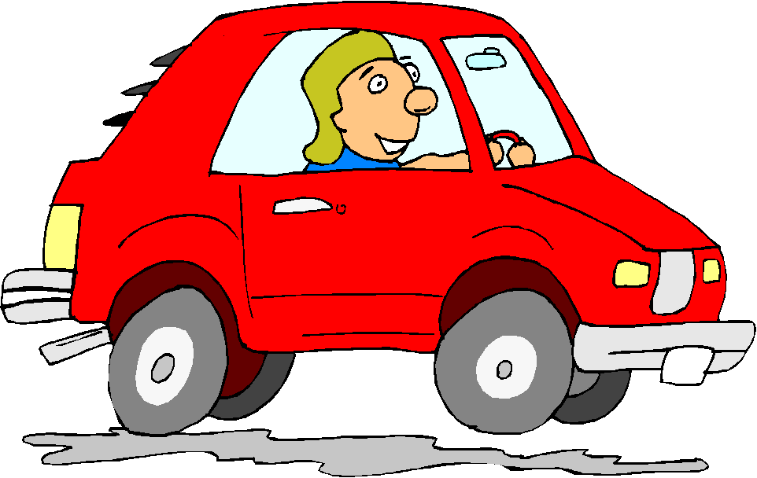
An object travels 16 m in 4 s and then another 16 m in 2 s. What is the average speed of the object?
2
Given :
Total distance travelled
= 16 + 16
= 32m
Total Time
= 4 + 2
= 6 s
To find :
Average speed
= ?
Total distance travelled
Formula :
Average speed
=
Total time taken
t₁ = 4 s
Total distance travelled
t₁ = 2 s
Solution :
Average speed
=
Total time taken
32
A
16 m
B
=
16 m
C
6
=
5.33 m s^{–1}
Ans :
The average speed of the object is 5.33 m s^{–1}.

Slide 38

3
Usha swims in a 90 m long pool. She covers 180 m in one minute by swimming from one end to the other and back along the same straight path. Find the average speed and average velocity of Usha.
Total distance
3
Given :
= 180 m
180
Average speed =
=
3 m s⁻¹
Total displacement
= 0 m
60
Usha swims back to the same position
1
Total Time
= 1 min
= 60 s
As displacement is zero,
To find :
Average speed
= ?
Average velocity =
0 m s⁻¹
Average velocity
= ?
Ans :
The average speed of Usha is 3 m s^{–1} and her average velocity is 0 m s^{–1}.
Total distance covered
Distance covered
s = 90 + 90 = 180 m
Formulae :
Average speed =
Total time taken
Total displacement
Average velocity =
Total time taken
Total distance covered
A
Average speed =
B
Solution :
Total time
t = 1 min
90 m
Total time taken

Slide 39
Motion
Acceleration
Types of acceleration

Slide 40
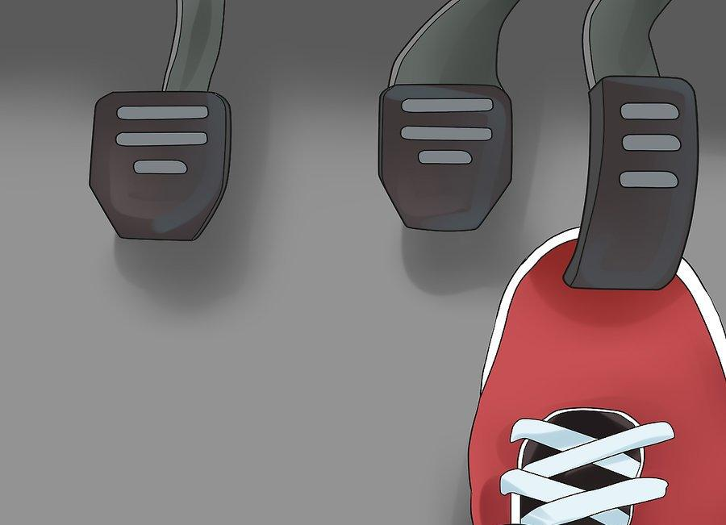
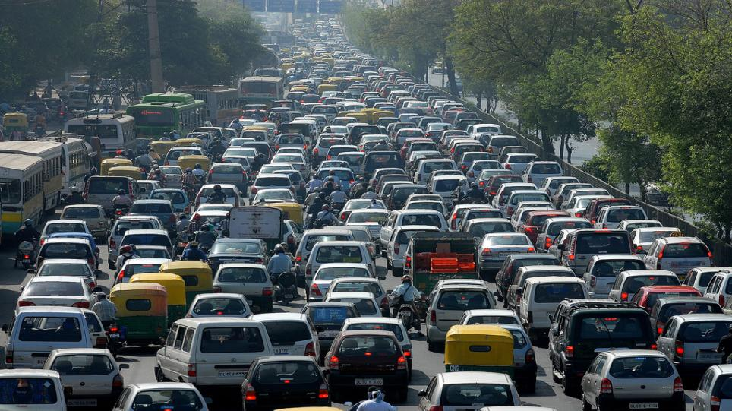

On a busy road the velocity of the vehicles changes with time
Acceleration (a)
Difference in velocity
The rate of change of velocity is called acceleration.
Final velocity − Initial velocity
Time
Change in velocity
Time
Velocity changes with time
Acceleration =
Acceleration =
a
Acceleration =
Velocity in the beginning
cm/s
Velocity after some time
m/s
v - u
u
a =
Initial velocity =
t
s
s
Accelerator
Final velocity − Initial velocity
Time
Acceleration =
UNIT
Final velocity =
v
m
M.K.S
=
Time =
t
s²
cm
C.G.S
=
s²

Slide 41
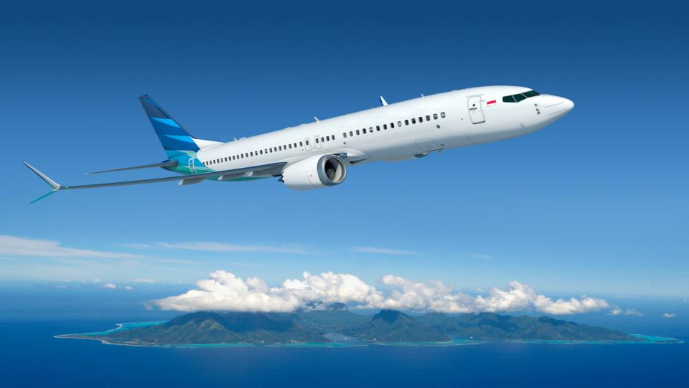
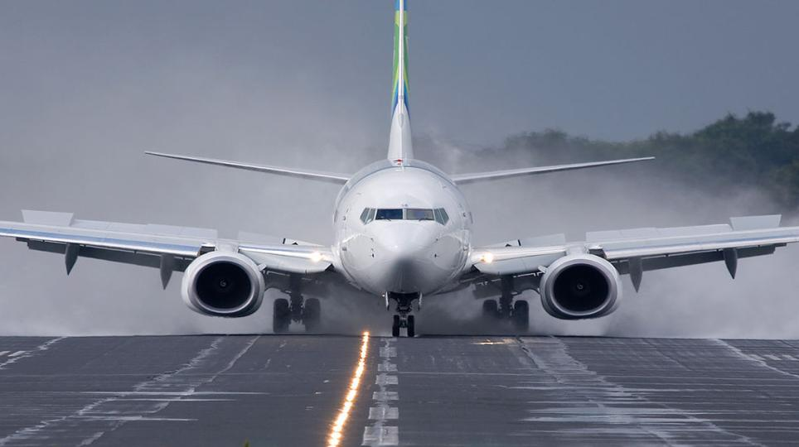
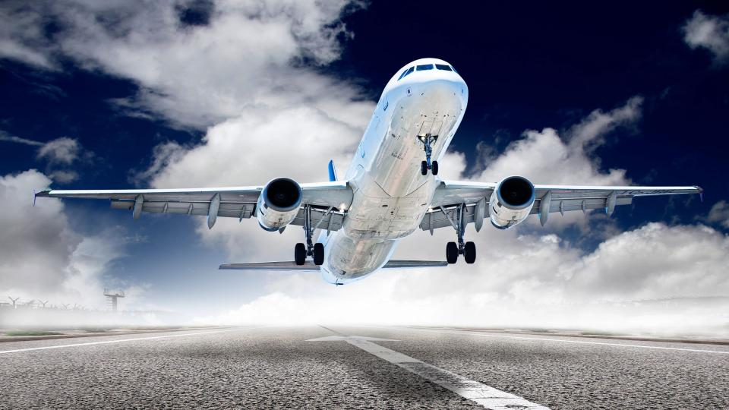

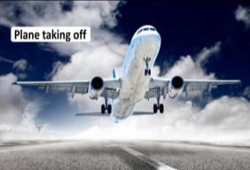
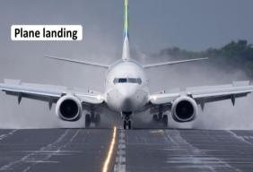
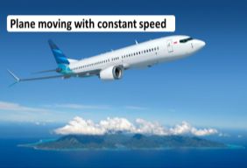
Plane moving with constant speed
Plane landing
Plane taking off
Positive
Negative
Zero
Velocity ­↑
Velocity ­↓
Velocity = constant
Retardation or Deceleration

Slide 42


1 – Earth rotating on its axis is an example of ………..
A
Positive acceleration
B
Negative acceleration
C
Zero acceleration
D
None of these
1 – A car starting from rest and moving is an example of
A
Positive acceleration
B
Negative acceleration
C
Zero acceleration
D
None of these

Slide 43
3 - The distance travelled by a body in a given direction in unit time is called ___________.
A
velocity
B
speed
C
velocity or speed
D
acceleration
4 - Which of the following statements is correct.
A
Units of speed & velocity are different
B
Units of velocity & acceleration all same
C
Units of speed & velocity are same
D
Units of speed & velocity are same only in MKS system

Slide 44
1
A bus decreases its speed from 80 km h^{–1} to 60 km h^{–1} in 5 s. Find the acceleration of the bus.
v - u
Given :
Initial speed (u)
= 80 km h^{–1}
Solution :
a =
40
5
t
= 80 ×
m s^{–1}
16.66 – 22.22
18
=
9
5
= 22.22 m s^{–1}
∴
a
=
- 1.112 m s^{–2}
Final speed (v)
= 60 km h^{–1}
10
5
m s^{–1}
Ans :
The acceleration of the bus is
- 1.112 m s^{–2}.
The negative sign indicates that the velocity of bus is decreasing.
= 60 ×
18
3
= 16.66 m s^{–1}
Time taken (t)
= 5 s
To find :
Acceleration (a)
= ?
v - u
Formula :
a =
t

Slide 45
2
A train starting from a railway station and moving with uniform acceleration attains a speed 40 km h^{–1} in 10 minutes. Find its acceleration.
Given :
Initial speed (u)
= 0 km h^{–1}
v - u
Solution :
a =
Final speed (v)
t
= 40 km h^{–1}
20
5
11.11 – 0
= 40 ×
m s^{–1}
=
18
600
9
= 11.11 m s^{–1}
11.11
Time taken (t)
= 10 min
=
600
= 10 × 60 s
∴
a
=
0.0185 m s^{–2}
= 600s
To find :
Acceleration (a)
= ?
v - u
Formula :
a =
t
Ans :
The acceleration of the train is 0.0185 m s^{–2}

Slide 46
Motion
Uniform and non uniform Acceleration

Slide 47

UNIFORM AND NON-UNIFORM ACCELERATION
Time in
second
Velocity in m/sec.
UNIFORM ACCELERATION
If there are equal changes in velocity of body in equal intervals of time, then it possesses uniform acceleration.
0
0
The difference between two instance of time is 5 seconds
5
8
The change in velocity in the time interval is constant.
5
5
8
8
At 10 seconds, velocity is 16 m/sec
10
5
16
So, there is equal intervals of time
8
At 35 seconds, velocity is 56 m/sec
Equal changes in velocity (8 m/s)
At 5 seconds, velocity is 8 m/sec
15
5
24
8
To start with the van is at rest
So the van is moving with uniform acceleration
20
5
32
8
At zero time, velocity is zero
Time
Velocity
25
5
40
8
0
0
5
10
35
8
16
30
5
48
8
56
35
56

Slide 48
NON-UNIFORM ACCELERATION
Time in
second
Velocity in m/sec.
If there are unequal changes in velocity of body in equal intervals of time, then it possesses
Non-uniform acceleration.
Equal intervals of time
The difference between two instants of time is 5 seconds
The change in velocity in time interval varies.
0
5
0
7
5
7
Unequal changes in velocity
5
8
10
15
5
11
15
26
Velocity changes with time
5
4
So the van is moving with non -uniform acceleration
5
20
30
10
To start with, the van is at rest
At zero second, velocity is zero
5
25
40
8
5
30
48
4
35
52

Slide 49
When will you say a body is in (i) uniform acceleration, (ii) non-uniform acceleration?
Ans.
-If an object travels in a straight line and its velocity increases or decreases by equal amounts in equal intervals of time, then the body is said to be in uniform acceleration.
-For example, the motion of a freely falling body.
-If an object travels in a straight line and its velocity changes by unequal amounts in equal intervals of time, then the body is said to be in non-uniform acceleration.
-For example, if a car is travelling along a straight road and passes through a crowd, suffers unequal change in velocity, in equal intervals of time, so the car is moving with non-uniform acceleration.

Slide 50
LECTURE 4

Slide 51
Motion
Basic concept of graph
Distance time graph for uniform motion

Slide 52



What quantity should be taken in X and Y axis ?
Y
E.g. Two variables Time and Distance
dependent variable
distance
X'
O
X
time
Independent variable on X and dependent variable on Y axis
independent variable
Y'

Slide 53
Distance-time Graph for Uniform motion
Time (sec) | Distance (metre)
0 | 0
5 | 7
10 | 14
15 | 21
20 | 28
25 | 35
Y
Scale : On X axis 2 cm = 5 second
On Y axis 1 cm = 7 metre
(25, 35)
35
(20, 28)
28
(15, 21)
21
(10, 14)
Distance in metre
14
(5, 7)
7
The graph is a linear graph.
The straight line in the distance time graph shows that the distance is increasing with time
The body is said to have a uniform motion
(0, 0)
O
5
10
15
20
X
25
Time in second

Slide 54
Motion
Finding velocity in distance-time graph
by slope method
Distance time graph for non-uniform motion

Slide 55
Find the velocity of the object in given graph
Velocity =
Slope of distance - time graph
?
For example :
Consider points A (5, 7) and
B (10, 14)
Then slope =
(x₁)
(y₁)
Distance-time Graph
Y
(x₂)
(y₂)
(25, 35)
y₂ – y₁
35
x₂ – x₁
(20, 28)
28
14 – 7
(15, 21)
=
s₂ – s₁
21
10 – 5
Distance in metre
t₂ – t₁
(10, 14)
7
metre
14
=
B
(x₂)
(y₂)
5
second
(5, 7)
Formula for velocity is
= 1.4 m/sec
7
A
(x₁)
(y₁)
(0, 0)
O
5
10
15
20
X
25
Time in second

Slide 56
Find the velocity of the object in given graph
Slope of distance - time graph
Velocity =
?
For example :
Consider points A (5, 7) and
B (10, 14)
Then slope =
(x₁)
(y₁)
Y
Distance-time Graph
(25, 35)
(x₂)
(y₂)
s₂ – s₁
35
t₂ – t₁
(20, 28)
28
28 – 21
(15, 21)
B
(s₂)
(t₂)
=
21
20 – 15
Distance in metre
A
(s₁)
(t₁)
metre
(10, 14)
7
14
=
5
second
(5, 7)
= 1.4 m/sec
7
(0, 0)
O
5
10
15
20
X
25
Time in second

Slide 57

Distance-time graph for Non-uniform motion
Time (sec) | Distance (metre)
0 | 0
2 | 1
4 | 4
6 | 9
8 | 16
10 | 25
12 | 36
14 | 49
Y
Scale : On X axis 1 cm = 2 units
On Y axis 1 cm = 10 units
70
60
(14,49)
50
40
(12,36)
30
(10,25)
Distance in metre
20
(8,16)
(6,9)
10
(2, 1)
(4,4)
The body covers unequal distance in equal intervals of time
Hence this graph is for non-uniform motion
The graph shows that distance increases with time.
The nature of the graph is non-linear
X'
2
4
6
8
10
12
14
16
X
Y'
Time in second

Slide 58
Motion
Velocity time graph for uniform motion
Finding distance travelled by an object in velocity-time graph for uniform motion

Slide 59


VELOCITY - TIME GRAPH FOR UNIFORM MOTION
Y
Scale : On X axis 1 cm = 1 unit
On Y axis 1 cm = 10 units
60
B (3, 50)
50
A
B
C (6, 50)
C
40
150 m
Consider point C (6, 50)
Velocity = 50 m/s
Time = 6 s
Consider point B (3, 50)
Velocity = 50 m/s
Time = 3 s
30
Distance up to B
= Velocity × Time
= 50 × 3
= 150 m
Velocity (m / sec)
300 m
Distance up to C
= Velocity × Time
= 50 × 6
= 300 m
20
10
E
t₁
D
t₂
1
2
3
4
5
6
X
Time in Sec

Slide 60
VELOCITY TIME GRAPH FOR UNIFORM MOTION
Y
P
Q
Scale :
On X axis 1 cm = 1 unit
On Y axis 1 cm = 10 units
60
B (3, 50)
C (6, 50)
A
B
C
50
?
150 m
Distance covered by boy from B to C
= Distance AC – Distance AB
= 300m – 150m
= 150 m
40
150 m
Velocity (m / sec)
30
300 m
20
10
E
t₁
t₂
D
1
2
3
4
5
6
X
Time in Sec.

Slide 61
Y
P
Q
60
A (3, 50)
B (6, 50)
50
40
Velocity (km / hr)
30
20
10
S
t₁
t₂
R
X
1
2
3
4
5
6
Time in Hrs.
Velocity Time Graph For Uniform Motion by Graphical Method,
Distance covered by boy from B to C = A (oBCDE)
= l × b
= 50 × 3
= 150 m
Y
60
Distance covered by boy = Area of rectangle
Breadth = 3 s
BCDE is a Rectangle
B
C
50
(3, 50)
(6, 50)
40
30
Length = 50 m
Velocity (m / sec)
20
10
Time in Seconds.
E
D
1
2
3
4
5
6
X

Slide 62
Motion
Velocity-time graph for uniformly accelerated motion

Slide 63

Velocity - Time Graph for Uniformly Accelerated Motion
Y
Scale : On X axis 1 cm = 5 units
On Y axis 1 cm = 8 units
Time in
second
Velocity in m/sec.
56
(35,56)
Thus, for all uniformly accelerated motion, the Velocity-Time graph is a straight line.
For non-uniformly accelerated motion, the Velocity-Time graph can have any shape according to the variation in velocity with respect to time.
0
0
48
(30,48)
5
8
Changes in the velocity of a car at regular intervals of time are given in the table. Draw a Velocity-Time graph.
40
(25,40)
10
16
32
15
24
(20,32)
Velocity in m/s
20
32
24
(15,24)
25
40
16
30
48
(10,16)
8
35
56
(5,8)
O
5
10
15
20
25
30
35
X
(0,0)
Time in second

Slide 64
Velocity - Time Graph for Uniformly Accelerated Motion
Distance travelled Consider time interval from 10 seconds to 20 seconds
Scale : On X axis 1 cm = 5 units
On Y axis 1 cm = 8 units
Y
Distance travelled Between D and C
= A (oABCD)
56
=
A (oAECD) + A (∆ABE)
48
1
40
B
=
(l × b)
+
× b × h
2
32
1
=
(16 × 10)
× 10 × 16
+
Velocity in m/s
2
24
h
A
=
160
+
80
b
E
16
= 240 m
l
8
D
b
C
O
5
10
15
20
25
30
35
X
Time in second

Slide 65
Velocity - Time Graph for Uniformly Accelerated Motion
Acceleration =
?
Slope of Velocity-Time graph
Scale : On X axis 1 cm = 5 units
On Y axis 1 cm = 8 units
Consider points A (10, 16) and B (20, 32)
Y
(x₁)
(y₁)
(x₂)
(y₂)
56
y₂ – y₁
48
Then slope =
x₂ – x₁
40
B
32 – 16
32
(20, 32)
=
(x₂)
(y₂)
20 – 10
Velocity in m/s
24
16
A
=
16
(10, 16)
10
(x₁)
(y₁)
= 1.6 m/s²
8
O
5
10
15
20
25
30
35
X
(0,0)
Time in second

Slide 66

Slope
Slope
How to be sure if we have to find
SLOPE or AREA ?
Distance – Time graph
Velocity – Time graph
Acceleration – Time graph
Area
Area

Slide 67
LECTURE 5

Slide 68
Motion
Equations of motion

Slide 69

There are three equations which help us to study Motion
They are called KINEMATICAL EQUATIONS OF MOTION

Slide 70

EQUATIONS OF MOTION
v
Does not depend on MASS
Final velocity =
𝒗 = 𝒖 + 𝒂𝒕
Initial velocity =
u
Since this equation gives the relation between VELOCITY and TIME, it is called the VELOCITY-TIME RELATION
Since this equation gives the relation between DISPLACEMENT and VELOCITY, it is called the DISPLACEMENT -VELOCITY RELATION
1
at²
s = 𝒖t +
a
2
Acceleration =
Since this equation gives the relation between DISPLACEMENT and TIME, it is called the DISPLACEMENT -TIME RELATION
Time =
t
𝒗² = 𝒖² + 2𝒂s
Displacement =
s

Slide 71


EQUATIONS OF MOTION BY GRAPHICAL METHOD
at t = 0
u
Y
at t
v
At time t=0, let the velocity be u (initial velocity)
Initial velocity u = OD
Final velocity v = OC
Time t = OE
A
s
B
Time | Velocity
0 | u
t | v
C
B
v
let s be the displacement
OC = OD + CD
Consider the motion of the bus along a straight line with uniform acceleration
At time t, let the velocity be v (final velocity)
v - u
∴ CD = OC - OD
Velocity
∴CD = v - u
..... (1)
Since we have the values of velocity and time, we can plot a Velocity-Time graph
u
t
v
A
D
Final velocity – Initial velocity
u
CD = Change in velocity
u
t
E
O
X
t
Time

Slide 72
1. Equation for velocity-time relation
1st kinematical equation :- v = u + at
OC = OD + CD
∴ CD = OC - OD
Change in velocity
Acceleration =
∴ CD = v - u
Time = t
..... (1)
Time
Change in velocity = CD
CD
a =
C
B
t
v
Acceleration = a
at =
CD
at
Velocity
v - u
∴ CD =
at
……….(2)
t
v
u
A
D
From eq. 1 and 2,
u
u
v - u = at
t
E
O
t
X
First kinematical equation
Time
v = u + at

Slide 73
2. Equation for Displacement-time relation
2nd kinematical equation :-
1
s = ut +
at²
2
Distance travelled = Area of quadrilateral DOEB
s = A (quadrilateral DOEB)
s = A (oDOEA) + A ( ΔDAB)
s =
(l × b) + ½ (b × h)
A of rectangle
= l × b
s =
(OE × AE)
+ ½ (DA × AB) ….(Eq.1)
A of triangle
= ½ (b× h)
C
B
But,
v
u
AE = u,
OE is the length of rectangle
AE is the breadth of rectangle
AB is the height of triangle
at
t
DA is the base of triangle
Velocity
OE = DA = t,
t
CD = AB = at
t
at
Quadrilateral DOEB is made up of
v
u
A
The shaded region is the area of quadrilateral
D
Substituting value in eq. 1
oDOEA
& ΔDAB
u
u
s =
( OE × AE )
+ ½ ( DA × AB ) ….(Eq.1)
t
E
O
t
X
Second kinematical equation
Time

Slide 74
3. Equation for Displacement-velocity relation
B
3rd kinematical equation :- v² = u² + 2as
Distance travelled = Area of oDOEB
D
s = Area of trapezium DOEB
1
s =
(OD + BE) × OE
2
O
E
But,
OD = u, BE = v, OE = t
1
C
B
s =
(v + u) × t
…..(i)
v
2
v - u
v - u
Now,
a =
Velocity
t
v - u
t
i.e. t =
…..(ii)
v
u
A
a
D
Substituting equation (ii) in equation (i) ,
u
u
1
(v - u)
s =
(v + u) × (v - u)
(a + b) × (a - b) = a² - b²
t
s =
(v + u) ×
E
2
2a
a
O
t
X
2as = (v + u) × (v – u)
Time
2as = v² – u²
v² = u² + 2as
Third kinematical equation

Slide 75
1
A trolley, while going down an inclined plane, has an acceleration of 2 cm s⁻². What will be its velocity 3 s after the start?
Given :
Initial velocity (u)
= 0 m s^{–1}
Acceleration (a)
= 2 cm s^{–2}
2
m s^{–2}
=
100
= 0.02 m s^{–2}
Time (t)
= 3 s
To find :
Final velocity (v)
= ?
Formula :
v =
u + at
Solution :
v =
u + at
∴
v =
0
+ (0.02 × 3)
∴
v =
0.06 m s^{–1}
Ans :
The velocity of the trolley after 3 seconds from start is 0.06 m s^{–1} .

Slide 76

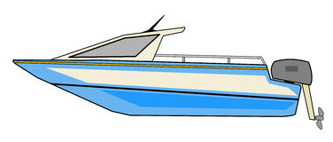
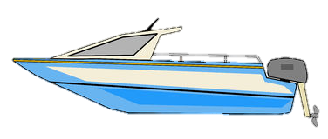
1
A motorboat starting from rest on a lake accelerates in a straight line at a constant rate of 3.0 m/s² for 8 s. How far does the boat travel during this time?
Given :
Initial velocity (u)
= 0 m/s
Acceleration (a)
= 3.0 m/s²
At rest,
u = 0
Acceleration
a = 3.0 m/s²
Time (t)
= 8 s
(i)
v = u + at
To find :
Distance covered (s)
= ?
1
1
Time
t = 8 s
(ii)
s =
ut +
at²
Formula :
s =
ut +
at²
2
2
1
Solution :
Distance covered (s)
=
ut +
at²
s
This formula is best suited as u, a and t are given
2
(iii)
v² = u² + 2as
1
=
0
× 8
Distance covered s = ?
+
× 3
× (8)²
2
Ans :
Boat travels a distance of 96 m
1
4
=
0
+
× 3
× 8 × 8
2
1
=
3
× 8
× 4
=
96 m

Slide 77
LECTURE 6

Slide 78
Motion
Circular motion
Uniform circular motion
Finding velocity of an object moving along a circular path

Slide 79

Let us consider a body moving along a closed path.
Circular Motion
Motion of the body along the circumference of the circle is called circular motion.
Uniform Circular Motion
Motion of the body along the circumference of the circle with constant speed is called uniform circular Motion.
Direction keeps on changing but magnitude of speed always remains same
This motion is also called as accelerated motion.

Slide 80
Let the body take ‘t’ seconds to go once round the path. If v is the speed then ……
Let us consider a body moving along a circular path of radius ‘r’.
Circumference of the circle
Speed
=
Time taken
2 πr
v
=
t

Slide 81
Motion
Numerical based on average speed and average velocity

Slide 82
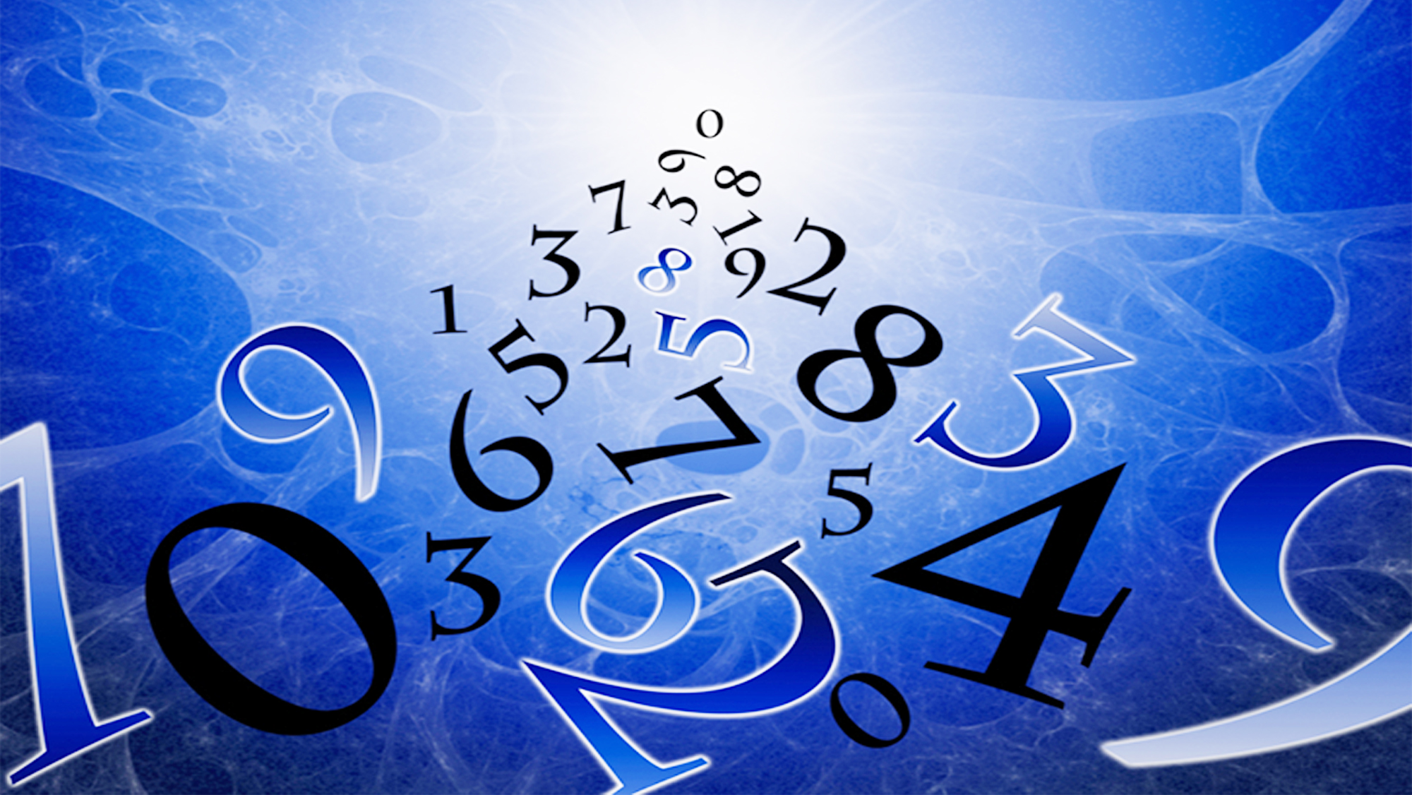

Type - A
Total distance covered
Average speed
=
numerical
Total time taken
Total displacement
=
Average velocity
Total time taken

Slide 83

1
The odometer of a car reads 2000 km at the start of a trip and 2400 km at the end of the trip. If the trip took 8 h, calculate the average speed of the car in km h^{–1} and m s^{–1}.
1 km = 1000m
Given :
Initial odometer reading
= 2000 km
5
1 h = 3600s
1000 m
5
Final odometer reading
= 2400 km
= 50
×
= 50
×
3600 s
18
Time (t)
= 8 h
18
∴
v_{av}
=
13.9 m s^{–1}
To find :
Average speed (v_{av})
= ?
2000 km
s
Final odometer reading
Initial odometer reading
2400 km
Formula :
v_{av}
=
t
Distance covered by the car, (s)
= Change in odometer reading
Solution :
= 2400
– 2000
= 400 km
t₁ = 8 h
s
400
Average speed of the car
v_{av}
=
=
t
8
A
B
= 50 km h^{–1}
Ans :
The average speed of the car is 50 km h^{–1} or 13.9 m s^{–1}.

Slide 84


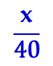
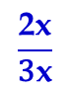

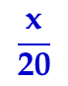
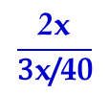
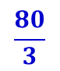
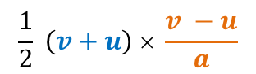


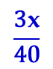
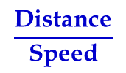
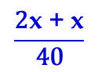
Abdul while driving to school, computes the average speed for his trip to be 20 km h⁻¹. On his return trip along the same route, there is less traffic and the average speed is 40 km h⁻¹. What is the average speed for Abdul’s trip?
2
Given :
Distance covered
= x + x
= 2x km
Total time for the
whole trip (T)
Average speed to school
= 20 kmh⁻¹
= t₁ + t₂
Average speed from school
= 40 kmh⁻¹
$$\frac{\text{x}}{\text{20}}$$
+
$$\frac{\text{x}}{\text{4}\text{0}}$$
Distance from school to home x km
Distance from home to school x km
=
Total distance covered by Abdul = x + x = 2x km
To find :
Average speed for Abdul's trip
= ?
$$\frac{\text{Distance} \text{covered} }{\text{Time} \text{taken} }$$
=
$$\frac{\text{2}\text{x}\text{ + }\text{x}}{\text{4}\text{0}}$$
=
$$\frac{\text{3}\text{x}}{\text{4}\text{0}}$$
Formula :
Average speed =
Time taken in forward trip at a speed of 20 km/h (t₁)
$$\frac{\text{Distance}}{\text{Speed}}$$
$$\frac{\text{Distance} \text{covered} }{\text{Time} \text{taken} }$$
Solution :
=
Average speed =
x km
=
$$\frac{\text{x}}{\text{20}}$$
… (i)
$$\frac{\text{2}\text{x}}{\text{3}\text{x}\text{/40}}$$
h
=
Time taken in return trip at a speed of 40 km/h (t₂)
$$\frac{\text{x}}{\text{4}\text{0}}$$
=
h
… (ii)
$$\frac{\text{2}\text{x}}{\text{3}\text{x}}$$
$$\frac{80}{3}$$
=
× 40
=
Ans :
Average speed for Abdul's trip is 26.67 kmh⁻¹.
=
26.67 kmh^{–1}

Slide 85
Joseph jogs from one end A to the other end B of a straight 300 m road in 2 minutes 50 seconds and then turns around and jogs 100 m back to point C in another 1 minute. What are Joseph’s average speeds and velocities in jogging (a) from A to B and (b) from A to C?
3
300 m
2 min 50 s
Given :
Distance A to B
= 300 m
170 s
Distance B to C
= 100 m
Time taken A to B
= 2 min 50 s
A
C
B
= (2 × 60) + 50
1 min
100 m
60 s
= 170 s
Solution :
(i) From A to B
Time taken B to C
= 1 min
Distance A to B
= 60 s
Average speed =
Time A to B
To find :
Average speed and velocity from
Shortest distance between A and B
300
(i)
A to B
(ii)
A to C
=
= 1.765 m s^{–1}
170
Distance
Formula :
(i) Average speed =
Displacement A to B
Time
Average velocity =
Time A to B
Displacement
(ii) Average velocity =
300
Time
=
= 1.765 m s^{–1}
170

Slide 86
Joseph jogs from one end A to the other end B of a straight 300 m road in 2 minutes 50 seconds and then turns around and jogs 100 m back to point C in another 1 minute. What are Joseph’s average speeds and velocities in jogging (a) from A to B and (b) from A to C?
3
(ii) From A to C
300 m
170 s
Distance A to C
=
AB
+ BC
=
300
+ 100
A
C
B
=
400 m
100 m
60 s
Total time A to C
=
Time A to B
+
Time B to C
Displacement A to C
=
170
+ 60
Average velocity =
Total Time A to C
=
230 s
200
Distance A to C
=
= 0.87 m s^{–1}
Average speed =
230
Shortest distance between A and C
Total Time A to C
400
Ans :
(i) The average speed and average velocity of Joseph from A to B are 1.765 m s^{–1}
=
= 1.739 m s^{–1}
230
Displacement A to C
=
AB
– BC
(ii) The average speed of Joseph from A to C is 1.739 m s ^{–1} and average velocity is 0.87 m s^{–1}
=
300
– 100
=
200 m

Slide 87
LECTURE 7

Slide 88
Motion
Numerical based on acceleration and equation of motion

Slide 89
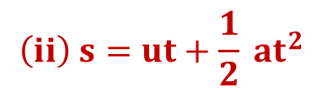
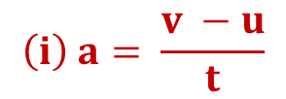
Type - B
numerical
$$\left(i\right) a= \frac{v −u}{t}$$
$$\left(ii\right) s=ut+\frac{1}{2} {at}^{2}$$
(iii)
v =
u + at

Slide 90
2
A car accelerates uniformly from 18 km h^{–1} to 36 km h^{–1} in 5 s. Calculate (i) the acceleration and (ii) the distance covered by the car in that time.
Given :
Initial velocity (u)
= 18 km h^{–1}
v - u
1
5
Solution :
(i)
a =
= 18 ×
t
18
1
10 – 5
5
= 5 m s^{–1}
=
=
Final velocity (v)
= 36 km h^{–1}
5
5
2
5
∴
a
=
1 ms^{–2}
= 36 ×
1
18
1
(ii)
s
=
ut +
at²
= 10 m s^{–1}
2
Time (t)
= 5 s
1
=
5
× 5
+
× 1
× (5)²
2
To find :
Acceleration (a)
= ?
=
25
+ 12.5
Distance covered (s)
= ?
=
37.5 m
v - u
(i)
a =
Formulae :
Ans :
The acceleration of the car is 1 m s^{–2} and the distance covered is 37.5 m.
t
1
(ii)
s =
ut +
at²
2

Slide 91
A bus starting from rest moves with a uniform acceleration of 0.1 m s^{–2} for 2 minutes. Find (a) the speed acquired, (b) the distance travelled.
3
Given :
Initial velocity (u)
= 0 m s^{–1}
1
(ii)
s
=
ut +
at²
Acceleration (a)
= 0.1 m s^{–1}
2
1
Time (t)
= 2 min
=
0
× 120
+
× 0.1
× (120)²
2
= 2 × 60 s
1
60
= 120 s
=
× 0.1
× 120 × 120
2
To find :
Speed acquired (v)
= ?
1
Distance travelled (s)
= ?
=
6 × 120
u + at
=
720 m
Formulae :
(i)
v =
1
Ans :
The speed of the bus is 12 m s^{–1} and the distance travelled is 720 m.
(ii)
s =
ut +
at²
2
Solution :
(i)
v =
u + at
=
0 + (0.1 × 120 )
∴
v
=
12 m s^{–1}

Slide 92
4
A racing car has a uniform acceleration of 4 m s⁻². What distance will it cover in 10 s after start ?
Given :
Initial velocity (u)
= 0 m s^{–1}
Acceleration (a)
= 4 m s^{–2}
Time (t)
= 10 s
To find :
Distance travelled (s)
= ?
1
Formula :
s =
ut +
at²
2
1
Solution :
s =
ut +
at²
2
1
2
=
0
× 10
+
× 4
× (10)²
2
1
=
2
× 100
=
200 m
Ans :
The distance covered by the racing car in 10 s is 200 m.

Slide 93
5
The brakes applied to a car produce an acceleration of 6 m s⁻² in the opposite direction to the motion. If the car takes 2 s to stop after the application of brakes, calculate the distance it travels during this time.
Given :
Acceleration (a)
= – 6 m s^{–2}
1
Time (t)
= 2 s
(ii)
s
=
ut +
at²
2
Final velocity (v)
= 0 m s^{–1}
1
∴
s
=
12
× 2
+
× (– 6)
× 2²
Initial velocity (u)
= ?
2
To find :
=
24
– 12
Distance travelled (s)
= ?
∴
s
=
12 m
Formulae :
(i)
v = u + at
Ans :
Thus, the car will move 12 m before it stops after the application of brakes.
1
(ii)
s =
ut +
at²
2
Solution :
(i)
v
= u + at
∴
0
= u
+ (– 6)
× 2
∴
u
= 12 ms^{–1}

Slide 94
Motion
Numerical based on uniform circular motion

Slide 95
Type - C
numerical
Circumference of the circle
Speed =
Time
Perimeter of field
Speed =
Time

Slide 96
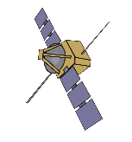

An artificial satellite is moving in a circular orbit of radius 42250 km. Calculate its speed if it takes 24 hours to revolve around the earth.
1
Time = 24 hrs
Given :
Radius of the circular path (r)
= 42250 km
Time taken to complete one round (t)
= 24 hours
To find :
Speed (v) = ?
r
distance
Formula :
Speed =
Circumference = 2πr
Time
Radius
r = 42250 km
2πr
Solution :
v =
t
11
21125
1
22 × 42250
=
2
×
7 × 24
12
6
11
×
21125
3
∴
v
=
7
×
3
∴
v
=
11065 km h⁻¹
Ans :
The speed of satellite = 11065 km h⁻¹

Slide 97


An athlete completes one round of a circular track of diameter 200 m in 40 s. what will be the distance covered and the displacement at the end of 2 minutes 20 s?
2
Given :
Diameter (d)
= 200 m
d
200
Radius (r)
=
=
= 100 m
2
2
Time for 1 round (t)
= 40 s
1 round of the circular track
r = $\frac{\text{d}}{\text{2}}$
= 100 m
To find :
(i)
Distance after 2 min 20 sec
= ?
(ii)
Displacement after 2 min 20 sec
= ?
d = 200 m
(i)
2πr
Solution :
Distance covered in 40 s =
Circumference of circle
= 2
× π
× 100
t = 40 s
= 200π m
5
Circumference of circle
200 π
Distance covered in 1 s =
= 5π m
40
40
1
Total time athlete run
= 2 min 20 s
= (2 × 60)
+ 20
= 140 s

Slide 98
An athlete completes one round of a circular track of diameter 200 m in 40 s. what will be the distance covered and the displacement at the end of 2 minutes 20 s?
2
∴
Distance covered in 140 s
= 5 π × 140
= 700 π m
100
22
= 700
×
1
7
= 2200 m
Distance covered in 140 s
d = 200 m
Number of rounds athlete runs
(ii)
=
Distance covered in 40 s
700 π
=
= 3.5 rounds
200 π
3.5 rounds =
3 full rounds + 1 half round
Displacement
= Diameter of track
Person is at the opposite side of the track after 3.5 round.
= 200 m
Ans :
After 2 min 20 s, the distance covered in 2200 m and displacement is 200 m

Slide 99
A farmer moves along the boundary of a square field of side 10 m in 40 s. What will be the magnitude of displacement of the farmer at the end of 2 minutes 20 seconds?
3
Given :
Side of the square field
= 10 m
B
10 m
C
perimeter
= 10 × 4
= 40 m
Time for 1 round (t)
= 40 s
(i)
Displacement after 2 min 20 sec
1 round of the field
To find :
= ?
A
D
(i)
40 m
Solution :
Distance covered in 40 s =
Perimeter of field
t = 40 s
1
40
Perimeter of field
Distance covered in 1 s =
= 1 m
40
1
40
Total time farmer moves
= 2 min 20 s
= (2 × 60)
+ 20
= 140 s

Slide 100
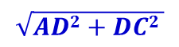
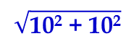
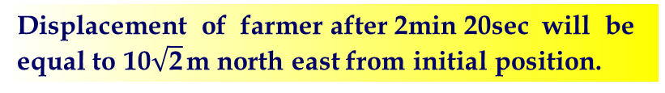
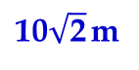
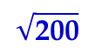
A farmer moves along the boundary of a square field of side 10 m in 40 s. What will be the magnitude of displacement of the farmer at the end of 2 minutes 20 seconds?
3
∴
Distance covered in 140 s
= 1 × 140
B
10 m
C
= 140 m
Number of rounds farmer completes
Distance covered in 140 s
=
Distance covered in 40 s
140
=
= 3.5 rounds
A
D
40
t = 40 s
3.5 rounds =
3 full rounds + 1 half round
Person is at the opposite side of the track after 3.5 round.
Displacement (AC)
=
$$\sqrt{AD2+DC2 }$$
=
$$\sqrt{\text{10}\text{2}\text{ + 10}\text{2}}$$
=
$$\sqrt{\text{200}}$$
$\text{10}\sqrt{\text{2}}$ m
Displacement of farmer after 2min 20sec will be equal to $\text{10}\sqrt{\text{2}}$ m north east from initial position.
Ans :
=

Slide 101
LECTURE 8

Slide 102
Motion
Numerical based on acceleration and equation of motion

Slide 103


Type - D
numerical
$$\left(i\right) 2as=v^{2}− u^{2}$$
$$\left(ii\right) a=\frac{v−u}{t}$$

Slide 104

1
Starting from a stationary position, Rahul paddles his bicycle to attain a velocity of 6 m s^{–1} in 30 s. Then he applies brakes such that the velocity of the bicycle comes down to 4 m s⁻¹ in the next 5 s. Calculate the acceleration of the bicycle in both the cases.
Given :
Initial velocity (u)
= 0 m s^{–1}
Case 2 : As Rahul applies brakes
v₂ = 4 ms⁻¹
u = 0
v₁ = 6 ms⁻¹
Velocity (v₁)
= 6 m s^{–1}
v₂ – v₁
4 – 6
– 2
Velocity (v₂)
= 4 m s^{–1}
a₂ =
=
=
t₂
5
5
Time (t₁)
= 30 s
∴
a₂ =
t₁= 30 s
t₂= 5 s
– 0.4 m s^{–2}
Time (t₂)
= 5 s
A
B
C
Ans :
The acceleration of the bicycle in the case 1 is 0.2 m s^{–2} and in the case 2, it is –0.4 m s^{–2}.
To find :
Acceleration a₁ and a₂
= ?
a₁ =
v₁ - u
a₂ =
v₂ – v₁
v - u
Formula :
a =
t₁
t₂
t
Solution :
Case 1 : As Rahul paddles
v₁ - u
6 – 0
a₁ =
=
t₁
30
∴
a₁ =
0.2 m s^{–2}

Slide 105


2
A ball is gently dropped from a height of 20 m. If its velocity increases uniformly at the rate of 10 ms⁻², with what velocity will it strike the ground? After what time will it strike the ground?
Given :
Initial velocity (u)
= 0 m s^{–1}
v - u
(ii)
a =
Displacement (s)
= 20 m
t
Acceleration (a)
= 10 m s^{–2}
v - u
20 – 0
∴
t
=
=
Initial velocity
u = 0
To find :
Velocity (v)
= ?
Displacement
s = 20 m
a
10
Time (t)
= ?
20
∴
t
=
10
20 m
Formulae :
(i)
v² = u² + 2as
v - u
∴
t
= 2 sec
(ii)
a =
t
Ans :
(i) It strikes the ground with a velocity of 20 ms^{–1}
(i)
Solution :
v² =
u² + 2as
Acceleration
a = 10 ms⁻¹
∴
v² =
(0)²
+ 2
× 10
× 20
(ii) It strikes the ground after 2 sec.
∴
v² =
400
∴
√
v =
400
∴
20 m s^{–1}
v =

Slide 106

A train starting from rest attains a velocity of 72 km h^{–1} in
5 minutes. Assuming that the acceleration is uniform, find (i) the acceleration and (ii) the distance travelled by the train for attaining this velocity.
3
Initial velocity (u)
= 0
v - u
Given :
Solution :
(i)
a =
Final velocity (v)
= 72 km h^{–1}
t
1
4
5
20 – 0
20
= 72 ×
m s⁻¹
=
=
18
300
300
1
15
= 20 m s⁻¹
1
∴
a
=
ms^{–2}
Total time (t)
= 5 minutes
15
u = 0
= 5 × 60 s.
(ii)
2as =
v² – u²
= 300 s.
200
2as =
v² – 0
To find :
Acceleration (a)
= ?
v²
(20)²
400 × 15
distance travelled (s)
= ?
s =
=
=
2a
2×(1/15)
2
1
v - u
=
3000 m
Formulae :
(i)
a =
t
=
3 km
Ans :
(ii)
2as =
v² – u²
The acceleration of the train is $\frac{\text{1}}{\text{15}}$ m s^{–2} and the distance travelled is 3 km.

Slide 107
4
A stone is thrown in a vertically upward direction with a velocity of 5 m s⁻¹. If the acceleration of the stone during its motion is 10 m s^{–2} in the downward direction, what will be the height attained by the stone and how much time will it take to reach there?
Given :
Initial velocity (u)
= 5 m s^{–1}
Final velocity (v)
= 0 m s^{–1}
(ii)
v - u
a =
Downward Acceleration
= 10 m s^{–2}
t
Upward Acceleration (a)
= - 10 m s^{–2}
v - u
0 – 5
- 5
t =
=
=
To find :
Height attained (s)
= ?
a
- 10
- 10
Time taken (t)
= ?
t = 0.5 s
Formulae :
(i)
2as =
v² – u²
v – u
(ii)
a =
t
Solution :
(i)
2as =
v² – u²
v² – u²
0² – 5²
– 25
∴
s
=
=
=
2a
2 (– 10)
– 20
Ans :
∴
s
= 1.25 m
The stone attains a height of 1.5m in 0.5 s

Slide 108
5
A train is travelling at a speed of 90 km h^{–1}. Brakes are applied so as to produce a uniform acceleration of – 0.5 m s⁻². Find how far the train will go before it is brought to rest.
Given :
Initial velocity (u)
= 90 km h^{–1}
5
5
= 90 ×
m s^{–1}
18
1
= 25 m s^{–1}
Final velocity (v)
= 0 m s^{–1}
Acceleration (a)
= – 0.5 m s^{–2}
To find :
Distance travelled (s)
= ?
Formula :
2as =
v² – u²
Solution :
2as =
v² – u²
v² – u²
0² – 25²
– 25²
∴
s
=
=
=
2a
2(– 0.5)
– 1
∴
s
= 625 m
Ans :
The train travels a distance of 625 m.

Slide 109
Motion
Numerical based on graph

Slide 110
Four cars A, B, C and D are moving on a levelled road. Their distance versus time graphs are shown in figure. Which car is the slowest?
Ans.
Speed = Slope of distance-time graph. The smaller the slope, the smaller is the speed.
A
B
C
From the figure, slope is minimum for car D. So, D is the slowest car.
Distance (m) →
D
Time (s) →

Slide 111
A girl walks along a straight path to drop a letter in the letter box and come back to her initial position. Her displacement-time graph is shown in Figure. Plot a velocity-time graph for the same.
A
100
C
Displacement (m)
Ans.
2
0
50
100
Time (s)
1
Velocity (ms^{–1}) →
0
20
40
60
80
100
– 1
– 2
Time (s)→

Slide 112

1
The distance-time graph of three objects A, B and C is shown.
Study the graph and answer the following questions.
(a) Which of the three is travelling the fastest ?
(b) Are all three ever at the same point on the road ?
(c) How far has C travelled when B passes A ?
(d) How far has B travelled by the time it passes C ?
From points
O, P and Q
Among ‘θ_{A}’, ‘θ_{B}’ and ‘θ_{C}’ which angle is greater?
To find how far ‘C’ has travelled ?
To find this we draw a line parallel to X- Axis
No
Y
B
C
A
a) ‘B’ travelling the fastest
12
b) Thus no, there are never at the same point on the road
Is there is a common point of intersection for the objects ‘A’, ‘B’ & ‘C’?
8
Distance (km)
c) Thus ‘C’ travels a distance of 6.4 km when ‘B’ passes ‘A
Point of intersection for the object ‘B’, & ‘A’?
From the point of intersection draw a line perpendicular to Y-axis
θ_{A}
From the point of intersection draw a line perpendicular to X-axis
Q
Which intersects Y- axis at 6.4 km
“C” makes on angle θ_{C} with the X-axis
“A” makes on angle θ_{A} with the X-axis
Which intersects Y- axis at 4 km
d) Thus ‘B’ travels a distance of 4 km when it passes ‘C’
4
“B” makes on angle θ_{B} with the X-axis
θ_{C}
Made by the object B
P
Yes, it’s ‘θ_{B}’
θ_{B}
X
0
0.4
0.8
1.2
1.6
O
Time (hour)

Slide 113
Motion
Numerical based on graph

Slide 114
A driver of a car travelling at 52 kmh⁻¹ applies the brakes & accelerator uniformly in the opposite direction, the car stops in 5 sec. Another driver going at 34 kmh⁻¹ in another car applies his brakes slowly & stops in 10 sec. On the same graph paper plot the speed versus time graphs for two cars. Which of the two cars travelled further after the brakes were applied?
1
Given :
Velocity of car₁ (u₁)
= 52 km h^{–1}
Velocity of car₂ (u₂)
= 34 km h^{–1}
Y
Time (t₁)
= 5 sec
60
Time (t₂)
= 10 sec
(52 kmh⁻¹)
A
To find :
Distance covered by first car
= ?
50
Distance covered by second car
Speed (km/h)
= ?
1
40
1
Distance covered
by the second car
C
(34 kmh⁻¹)
Distance covered
by the first car
=
OC × OD
=
AO × OB
= Ar ∆OCD
Solution :
The area under speed time graph represents distance travelled.
2
2
= Ar ∆AOB
30
5
5
1
1
1kmh⁻¹ =
=
ms⁻¹
1 kmh⁻¹ =
ms⁻¹
=
52kmh⁻¹ × 5
18
34kmh⁻¹ × 10
18
2
2
20
5
1
5
(10 s)
Ans :
1
=
34
ms⁻¹ × 10
The second car travels further after the brakes are applied
B
=
52
ms⁻¹ × 5
2
18
10
(5 s)
D
X
2
18
=
36.1m
=
47.2m
0
2
4
6
8
10
12
Time

Slide 115
The speed-time graph for a car is shown below.
(a) Find how far does the car travel in the first 4 seconds. Shade the area on the graph that represents the distance travelled by the car during the period.
(b) Which part of the graph represents uniform motion of the car?
2
To find :
(i) Distance travelled in first 4 s = ?
Shaded region is similar to a triangle
(ii) Part which represents uniform motion = ?
8
Solution :
6
Speed (ms^{–1})
(i)
The area under speed time graph represents distance travelled.
4
Distance travelled in first 4 s
h
1
2
Area of triangle
=
× b
× h
Area of shaded region
2
b
1
2
=
× 4
× 6
=
12 m
0
6
8
10
2
2
4
1
Time (s)
For uniform motion speed-time graph is a straight line parallel to x-axis.
(ii)
Ans :
Part of graph between 6 s to 10 s represents uniform motion of car.
Distance travelled in first 4 s is 12 m
(ii) Motion is uniform after the 6th second.

Slide 116
What can you say about the motion of an object whose distance time graph is a straight lint parallel to the time axis?
Ans.
The object is stationary, i.e., at rest.
Y
s
X
t

Slide 117
What can you say about the motion of an object if its speed-time graph is a straight line parallel to time axis?
Ans.
It indicates that the object is moving with uniform speed.
Y
v
X
t

Slide 118
What is the shape of velocity-time graph for non-uniformly accelerated motion?
Ans.
The velocity-time graph for non-uniformly accelerated motion can have any shape.

Slide 119
Draw the distance-time graph for a car moving with non-uniform speed.
Ans.
Distance (in m) →
Time (s) →

Slide 120
Draw the velocity-time graph of an object moving with uniform velocity.
Ans.
Velocity →
Time →

Slide 121
Plot a speed-time graph when the body is under non-uniform acceleration?
Ans.
Speed →
Time →

Slide 122
Plot a speed-time graph when the body is under non-uniform retardation?
Ans.
Speed →
Time →

Slide 123
Draw a velocity-time graph when the speed changes alternatively.
Ans.
Velocity →
Time →

Slide 124
Plot the velocity-time graph when the velocity increases in a stepwise manner.
Ans.
Velocity →
Time →

